Slide 1
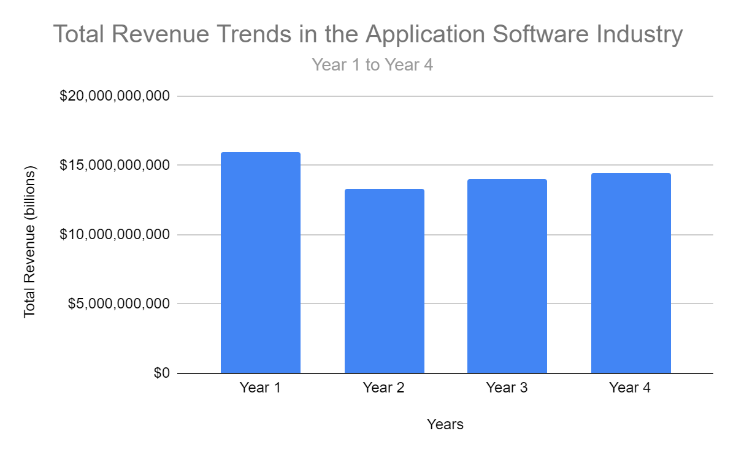
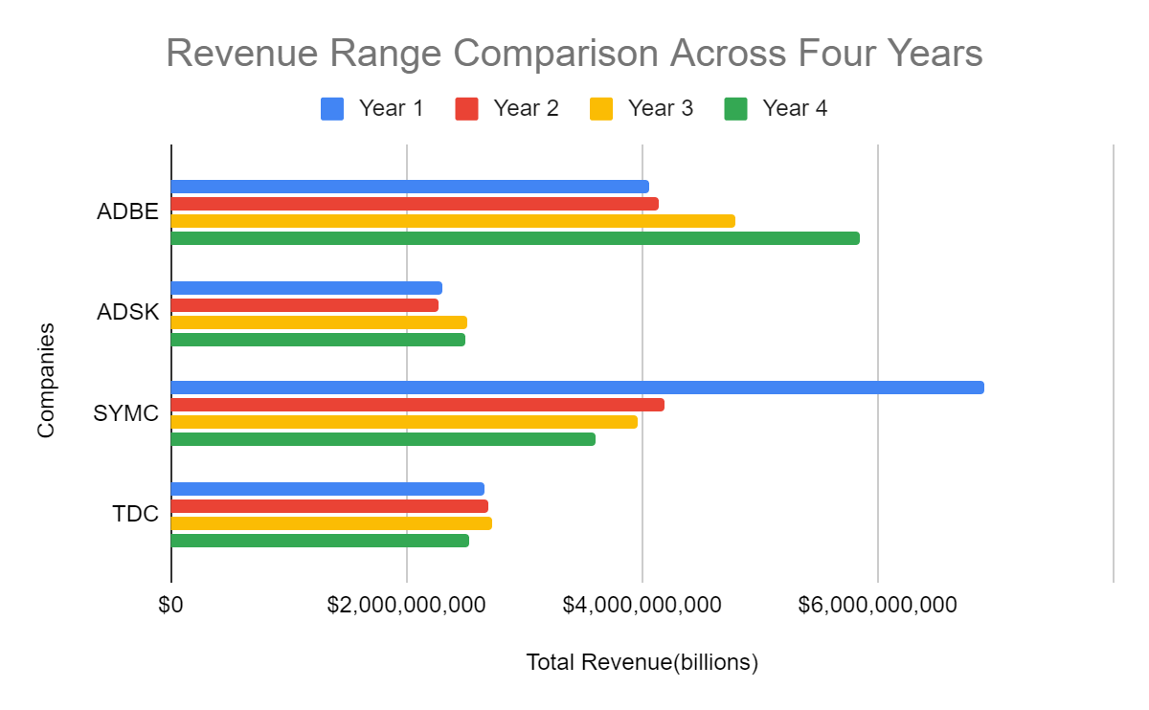
In the trend analysis of total revenue over the four-year period in the Application Software Industry, which company was responsible for the maximum total revenue, and what insights can be derived from this trend analysis?
Findings:
The overall trend in the Application Software Industry indicated revenue growth, with Year 4 being the most financially successful year collectively.
The total revenue in the Application Software Industry displayed a notable range, from a minimum of $13,295,965,000 in Year 2 to a maximum of $15,938,440,000 in Year 1, signifying a range of approximately $2.64 billion between the lowest and highest revenue years.
While the industry experienced fluctuations, the mean total revenue increased year-over-year, with Year 4 having the highest mean revenue of $3,622,132,500.
The range of total revenue values across the four years demonstrates the extent to which revenue fluctuated during this period. Year 4 had the widest range, exceeding $3.35 billion, indicating significant variations in revenue performance among companies within the industry during that year. This highlights the potential impact of external factors, market dynamics, or company-specific events on revenue.
Standard Deviation Analysis: The standard deviation values provide a measure of how individual revenue data points deviate from the industry's mean revenue. Notably, Year 4 exhibited the highest standard deviation (1.16), indicating greater dispersion in revenue compared to previous years. This suggests that in Year 4, revenue figures were more spread out from the mean, signifying increased variability and possibly greater market volatility.
The industry's revenue variance increased over the four years, with Year 4 having the highest variance (133.51%). This suggests that industry-wide revenue fluctuations became more pronounced in Year 4, possibly due to changing market conditions.
<visualization or summary statistics used for finding>

Slide 2
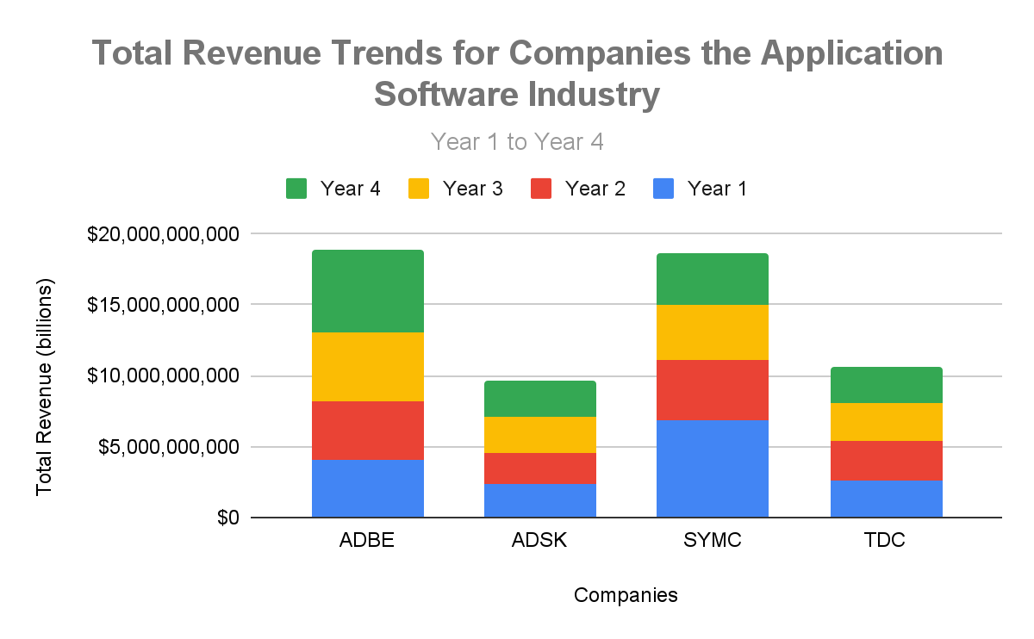
Continued….
<visualization or summary statistics used for finding>
Findings:
Adobe Inc. (ADBE) was responsible for the maximum total revenue in the Application Software Industry over the four-year period
Adobe Inc. (ADBE) demonstrated consistent revenue growth year over year, culminating in the highest revenue among the companies in Year 4, indicating sustained performance.
While Adobe showed significant growth, other companies in the industry, such as Autodesk, Inc. (ADSK), Symantec Corporation (SYMC), and Teradata Corporation (TDC), had varying revenue trends. Some experienced fluctuations, while others saw a decline in revenue during the four-year period.
The performance of individual companies, as observed in the trend analysis, contributed to the overall growth of the industry's total revenue.
.

